Slide 1
Making the Human Rights Performance of Countries More Transparent New data for use in research and advocacy
Anne-Marie Brook

Slide 2
The Human Rights Measurement Initiative (HRMI)
Global collaborative project - founded in late 2015
Hosted by Motu Economic and Public Policy Research
Contributors include human rights NGOs, academics, and others
Funded by philanthropic grants & donations

Slide 3
All HRMI metrics are grounded in International Human Rights Law
Universal Declaration of Human Rights (1948)
“All human beings are born free and equal in dignity and rights. They are endowed with reason and conscience and should act towards one another in a spirit of brotherhood.”
International Covenant on Economic, Social and Cultural Rights (1976)
International Covenant on Civil and Political Rights (1976)

Slide 4
“We tend to overvalue the things we can measure and undervalue the things we cannot.”
― John Hayes

Slide 5
Users of HRMI data
Policy makers, advisers, and researchers
Those who help direct capital flows
Human rights advocates
Governments & the United Nations
Those monitoring SDGs

Slide 7
13 countries in Civil and Political Rights pilot

Slide 8
Civil & Political Rights Methodology
Expert survey completed by in-country human rights practitioners
Best available information at the cross-national level
Survey sent to 20 - 50 potential respondents in each country
Encrypted, single response link
Survey asks questions about the type, frequency, and distribution of abuse
5 to 12 complete responses received per country
Bayesian statistical model aggregates responses into scores
Cross-nationally comparable
Honest about uncertainty

Slide 9
Economic and Social Rights Methodology
Uses publicly available statistics
Draws on article 2 of the ICESCR which requires each signatory state to fulfil these rights “progressively”, “to the maximum of its available resources” (concept of progressive realisation)
Selects summary indicators of each right
Can’t be gamed
Cover the key aspects of the right
Metric calculation requires three steps:
Measure actual enjoyment level of each right
Measure state obligation level
Express A as a % of B.

Slide 10
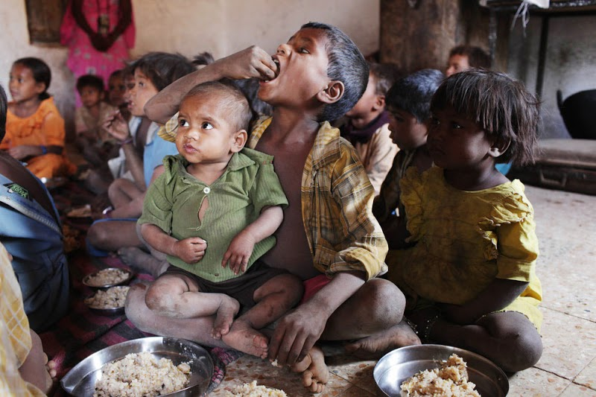
Example - Right to Food
Notes:
http://www.youthkiawaaz.com/2015/10/ten-facts-about-hunger/

Slide 11
Achievement Possibilities Frontier—Food

Slide 12
Achievement Possibilities Frontier—Food

Slide 13
Achievement Possibilities Frontier—Food

Slide 14
HRMI Website (to access data visualisations)
https://humanrightsmeasurement.org/

Slide 15
Who will use HRMI data?
“HRMI provides a comprehensive tool for shining more light on countries'
individual and comparative human rights performance. We also foresee its
usefulness in informing UN programming decisions.”
- Peggy Hicks, Director Thematic Engagement, Special Procedures and Right to Development Division, OHCHR
“HRMI provides comparative data about countries that staff at Human Rights Watch can use when planning their research, identifying priority issues to work on and crafting advocacy messaging. It is an important effort to provide a wide-angle view of human rights around the globe.”
- Iain Levine, Deputy Executive Director, Human Rights Watch

Slide 16
Who have we been seeking feedback from?
Human Rights NGOs
Amnesty
Human Rights Watch
Inter-governmental organisations
OECD
OHCHR
World Bank
In-country human rights experts
Pilot countries
Journalists
Various
Other civil society organisations
Various
Private sector
Oxford Analytica
Ecofin

Slide 17
Summary of feedback
On CPRs: results look sensible; give us more countries!
On ESRs:
People have to put on a different thinking cap to understand what the percentage scores show
Desire for much greater disaggregation
Overall comments
Good feedback on data visualisations
Journalists, along with much of the public, want rankings

Slide 18
Key priorities over the coming year
2018
Secure funding for next phase of work
Conduct security audit
Johannesburg co-design workshop (September)
Update ESR metrics and build capacity to conduct more disaggregated analysis
Scale up for expanded CPR data collection
2019
Roll out expert survey to expanded country list in Feb/March 2019
Publish updated dataset & visualisations by mid-2019

Slide 19
https://humanrightsmeasurement.org/
Email contacts:
anne-marie.brook@motu.org.nz
kcclay@uga.edu
susan.m.randolph@gmail.com

